Slide 1
Mid-Course Review
Front-End Web Development

Slide 2
Lesson Change Log FEWD 3.1 - 3.2
Below are the specific changes made in this lesson.
Returning Instructor Directions:
Click on the hyperlinks below, and it will direct you to the specific slide.
Copy the entire slide, and paste in your existing curriculum deck.
Rover (whole section) - Split this exercise into parts and created step-by-step instructions.
Final Project Checkpoint - Added a discussion about final projects, including teaching tips and suggestions for customization.
Share how the lesson went through our Instructor Lesson Exit Ticket - the Curriculum Feedback form: http://ga.co/curriculum-feedback

Slide 3
Pre-Class Materials and Preparation
This class is a single lab that should take the entire time block.
Starter Code Download
Solution Code Download
This lab uses a .zip folder of files, so this would be a good time to introduce a text editor to your students if you haven't already.

Slide 4
Mid-Course Review Lab
Overview
This lesson reviews the course content so far, allowing time for students to solidify the knowledge they've gained and ask necessary questions before moving further.
Learning Objectives
In this lesson, students will:
Apply CSS and JS skills to fit requirements of an assigned project.
Duration: 180 minutes

Slide 5
Suggested Agenda
Time | Activity | Purpose
0:00–0:30 | Q&A Review of JS So Far | There will likely be questions and a need for a review before jumping in to the review lab.
0:30–3:00 | Rover Mid-Course Lab | Cumulative challenge bringing together all the concepts from the course to this point.

Slide 6
Rover
Mid-Course Review Lab

Slide 7
Rover
120 minutes
It’s time to review what we’ve learned so far and combine all of our new skills by designing a responsive, interactive site called Rover. Your goal is to add CSS and JavaScript so that the site matches the provided screenshots and has the functionality requested in the JavaScript file.
Remember: Use your resources, ask questions, try things one step at a time, and don’t give up!
Starter / solution code: https://drive.google.com/drive/folders/18lIcF22YmViOQJ_YUgnjrWvjc7UhjxFF?usp=sharing
Notes:
TEACHING TIPS:
Feel free to adjust this to group or solo exercises to adapt to each student’s favored approach.

Slide 8
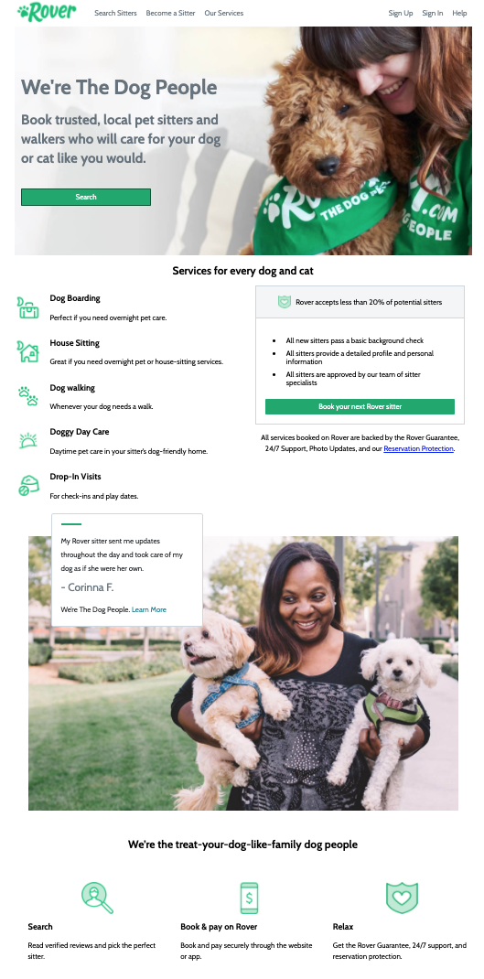
Identifying the Sections
As we did with the Airbnb Layout Lab, let’s break the site down into sections that we can focus on one by one:
Header
Hero Container
Facts Container
Action
1-2-3 Steps
Notes:
TEACHING TIPS:
Feel free to adjust this to group or solo exercises to adapt to each student’s favored approach.

Slide 9


The Header
We see two subsections of content in the header.
What content is hidden when the screen size is smaller?
What property value would we change to hide those elements?
Notes:
TEACHING TIPS:
Feel free to adjust this to group or solo exercises to adapt to each student’s favored approach.

Slide 10

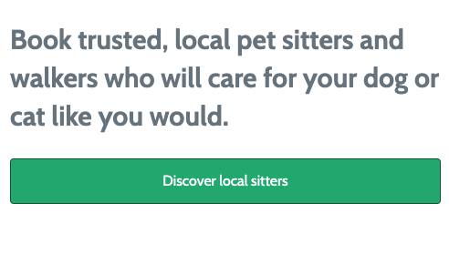
2. Hero Container
Here, we see a background image, and then content on top of the image.
Try creating the element with the image first, then adding content inside of that element.
What do we need to adjust at a smaller screen size?
Notes:
TEACHING TIPS:
Feel free to adjust this to group or solo exercises to adapt to each student’s favored approach.

Slide 11
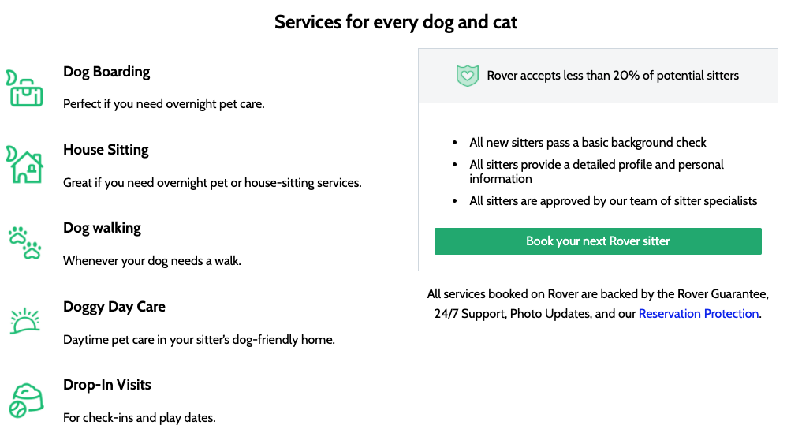
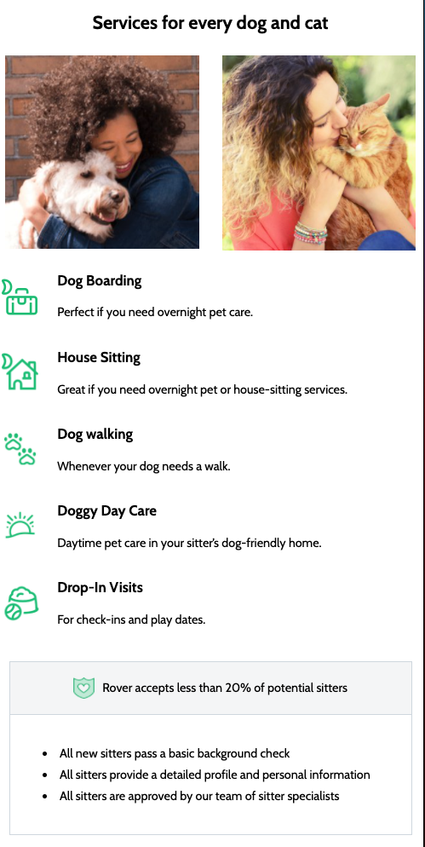
3. Facts Container
Focus on creating the two column layout:
In the first column, you have 5 child elements with the same layout.
In the second column, you’ll need several child elements for background color, spacing and borders.
Notes:
TEACHING TIPS:
Feel free to adjust this to group or solo exercises to adapt to each student’s favored approach.

Slide 12
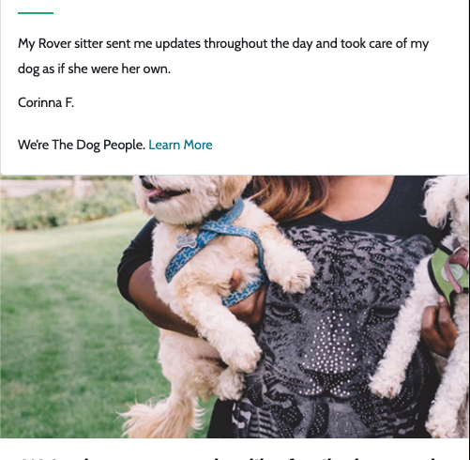
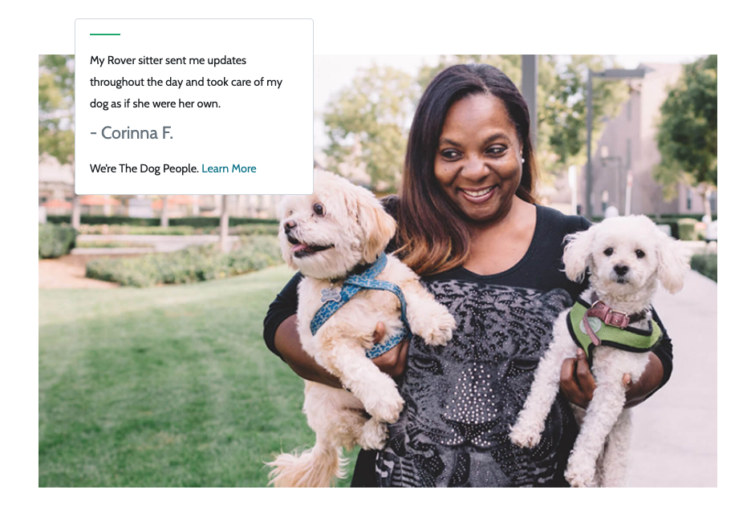
4. Action
In the mobile layout, the two elements are stacked.
In the larger screen layout, the testimonial is positioned on top of the image.
How can we position the testimonial like this?
Notes:
TEACHING TIPS:
Feel free to adjust this to group or solo exercises to adapt to each student’s favored approach.

Slide 13
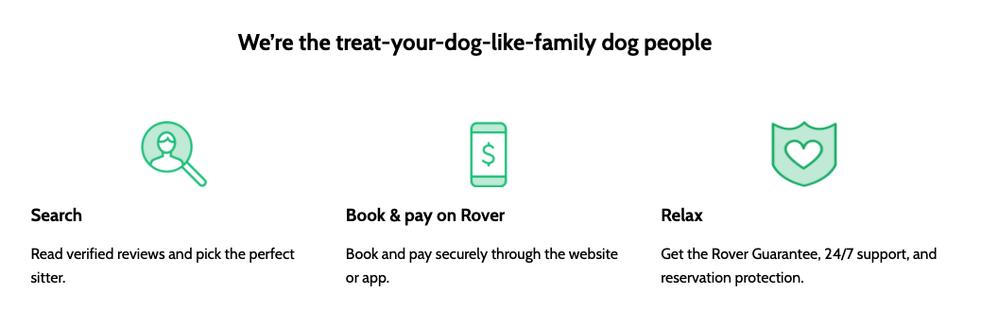

5. 1-2-3 Steps
There’s some sort of heading at the top.
Three columns, each with the same layout:
How do the columns change layout as the screen size adjusts?
What property value would we change to go from a flex row layout to a flex column layout?
Notes:
TEACHING TIPS:
Feel free to adjust this to group or solo exercises to adapt to each student’s favored approach.

Slide 14
Final Project Checkpoint
10 Minutes
This is a good place to start thinking about what you want to work on for your final project. Don’t wait until the last week!
Here are some questions for consideration:
What are you thinking of building for your final project?
Do you have ideas on the JS functionality you want to include?
What do you think will be the most difficult part of your project?
If you had more time to work on the project, what might you add to it?
Notes:
TEACHING TIPS:
Students shouldn’t leave this work until the last week! Make sure to check in with students weekly about final projects from here on out.
Students should make sure their final project idea is attainable in the time they have. If they’re unsure if an idea is too difficult, check with the instructional team — it may make sense to scale the MVP of the project down and save the idea as a nice-to-have.
Remind students that they can keep working on the project after the course ends as they keep learning and want to develop it as a portfolio piece!
Customize it! Edit this slide with the following:
Link to final project guidelines.
Add slide with milestones in a table.
Transfer the discussion questions to a Google form and share the link on the slide, so you will have a record of where students are with their final projects.

